Slide 1

E-Commerce Recommendation Systems
-Manoj Kumar
-Vamsi Krishna
-Purushotham
Mentor :
Dr . Amit Kumar

Slide 2
What is Recommendation System?
Recommended System is an information filtering technique , which provides users with information in which they are interested.
These recommendations can be based on items such as past purchases, demographic info, or their search history.
Netflix – Movie Recommendations
Amazon – Product recommendations
Facebook – Friend suggestions
Spotify – Song recommendations

Slide 3
Usage?
The idea is that if you can narrow down the pool of selection options for your customers to a few meaningful choices, they are more likely to make a purchase now, as well as come back for more down the road rather than letting them to get lost in huge database. For instance:
Netflix saves $1billion each year
35% of revenue in Amazon
23.7% increase in sales of Best Buy

Slide 4
Types
Content Based Filtering
- Item features and similarities(Text and Image).
Collaborative Filtering
- User Behaviour and Similarities.

Slide 5
Our Approach!
- Content Based filtering
Python
Data Acquisition
Data Cleaning
4. Text based product recommendations
TF-IDF & Word2Vec
5. Image based recommendations
CNN(Deep Learning)

Slide 6
TEXT BASED RECOMMENDATIONS
Term Frequency(TF) and Inverse Document Frequency(IDF)
TF defines how important a word is in a document.
TF = No of times term t present in document j / total no of terms present in that document j
IDF defines the rarity of a word to a collection of Corpus.
IDF = log(total no of documents present in our data/no of documents that contain term t)

Slide 7
TF-IDF
We use weighting factor for calculating Euclidean distances.
Weighting factor W = TF * IDF
The TF–IDF value increases proportionally to the number of times a word appears in the document and is offset by the number of documents in the corpus that contain the word, which helps to adjust for the fact that some words appear more frequently in general.

Slide 8
TF-IDF
Query : pink tiger t-shirt zebra stripes xl xxl
TF(pink,D1) = 1 / 7
IDF = log( #D / frequency of pink in total documents)
W = TF * IDF
pink | tiger | t-shirt | zebra | stripes | xl | xxl
0.26 | 0.51 | 0.22 | 0.5 | 0.47 | 0.25 | 0.32

Slide 9
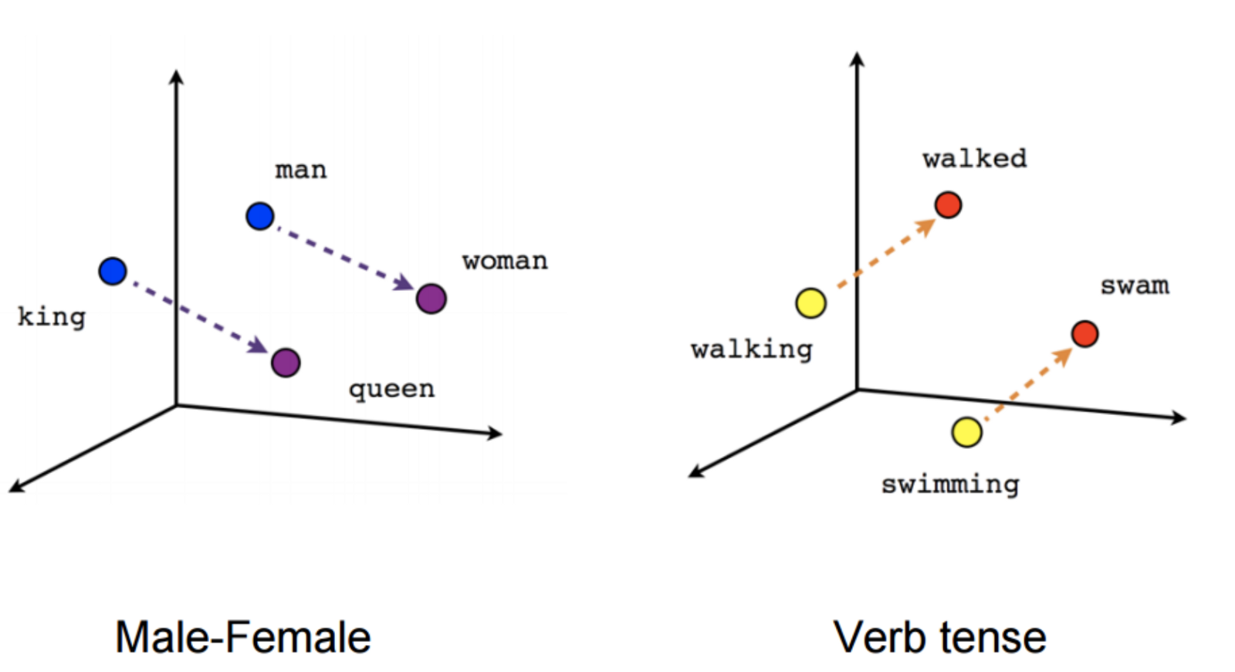
Word2Vec
Used to produce word embeddings
Semantic Similarity
Eg : Tiger & leopard

Slide 10
word2vec
Eg : D :w1w2 w4 w5 window size =2
Calculate Word2Vec on the
Account with TFIDF
P=exp(U0/V)/(#exp(Ui/V)
W3
 | w1 | w2 | w3 | w4 | w5
w1
w2
w3
w4
w5

Slide 11
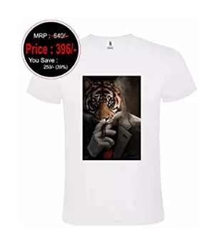
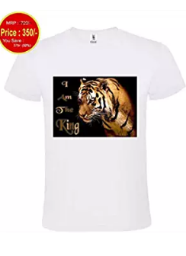
IMAGE BASED RECOMMENDATIONS
Convolutional Neural Network (CNN)
Deep learning technique
Image based search :
-edges, shapes, color, pattern etc

Slide 12
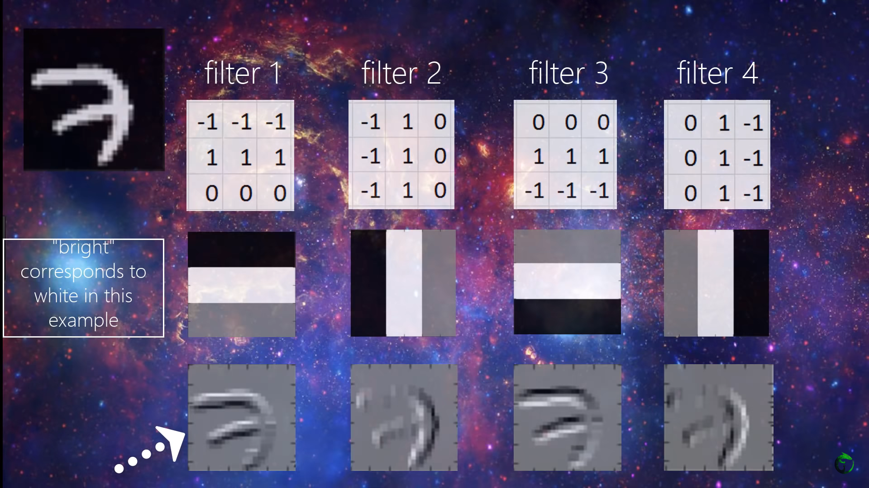

Slide 13
References
tensorflow.org/tutorials/representation/word2vec
https://www.researchgate.net/publication/311661450
https://skymind.ai/wiki/convolutional-network
https://www.researchgate.net/publication/291153115
https://www.youtube.com/watch?v=YRhxdVk_sIs
https://code.google.com/archive/p/word2vec/

Slide 14
Thank You

